Slide 1
Medicaid Eligibility Introduction and Overview
Kyle Fisher
kfisher@phlp.org
November 2016

Slide 2
Topics
Medicaid Eligibility Basics
MAGI Categories
Adult (expansion)
Children & Pregnant women
MAGI Income & Household Size Rules
Immigration status
Disability-related Categories
Healthy Horizons
MAWD
Notes:
Poll audience – how many do assist patients medicaid elig & enrollment?

Slide 3
Eligibility Basics
Residency
Category
Income Limits
Immigration Status

Slide 4
Eligibility Basics
3-step analysis for each person
What category does the person fit in?
What is the person’s household size?
Is the person under the income limit for that category and household size?

Slide 5
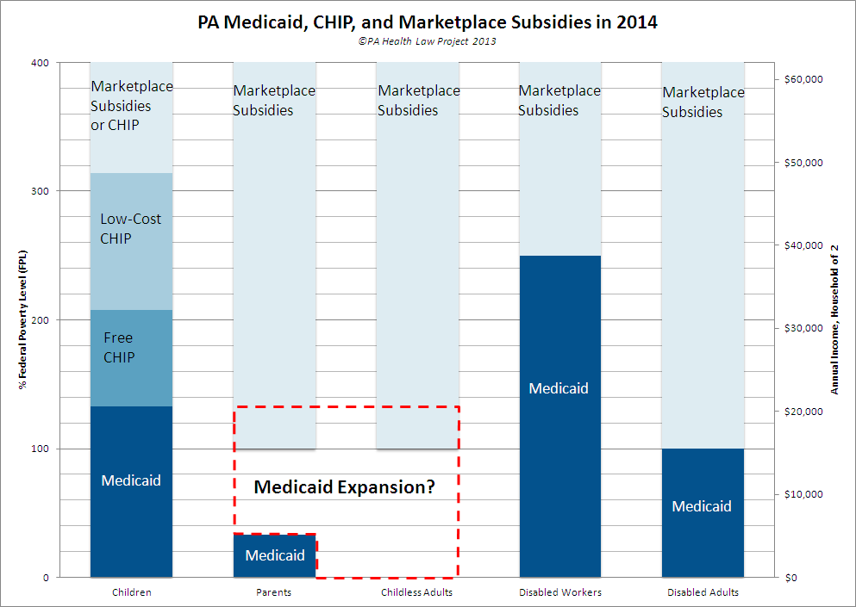
Notes:
Categories that existed before expansion, continue to exist, worth keeping in mind

Slide 6
Category
Categorical Eligibility
MAGI
Adults (Expansion)
Children
Pregnant Women
*no resource test
Non-MAGI
Persons with Disabilities
Workers with Disabilities
Seniors
Diagnosis of Breast or Cervical Cancer
Notes:
Income rules – household rules, still tied to category
*no resource test in MAGI categories

Slide 7
Medicaid Income Limits
Income Eligibility (MAGI Categories)
Infants
(age 0-1)
Children
(age 1-5)
Children
(age 6-18)
*Includes 5% disregard
FPL
220%
162%
138%
Pregnant Women
Adults
(expansion)
*See MAEH 312 Appendices
FPL
220%
138%

Slide 8
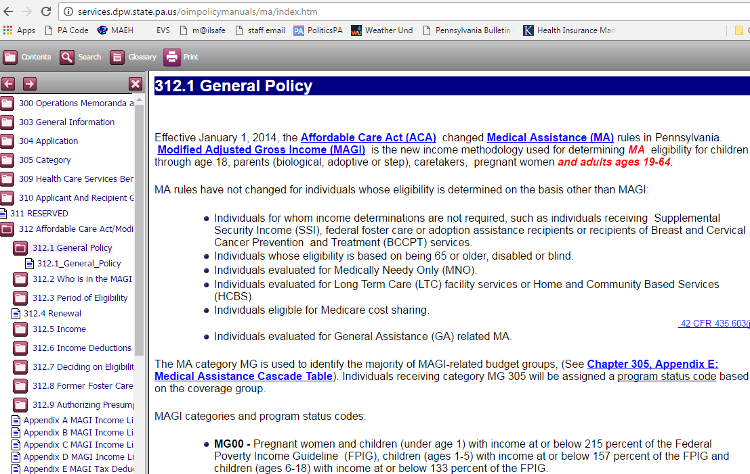
Medical Assistance Eligibility Handbook (MAEH)
Notes:
- reference & authority (for caseworkers)

Slide 9
Medicaid Eligibility
MAGI Adult Category
(aka Medicaid expansion)

Slide 10
Newly Eligible Adults
Adults age 19-64
Income under 138% FPL
Cannot qualify for Medicare
No asset test
 | Household of 1 | Household of 2 | Household of 3 | Household of 4
138% FPL (2016) Monthly | $1,367 | $1,843 | $2,319 | $2,795
Annually | $16,394 | $22,108 | $27,821 | $33,534
Notes:
- new elig category remarkable in breadth – no EAF, no HSM, no LOCA, no verifying car’s worth or life insurance or retirement assets – no precedent in PA
- historically MA tied to CA & SSI, pregnancy – idea of worthy poor – changes with ACA

Slide 11
Example
Kanye (age 32) and Kim (age 34) live off Kim’s Social Security Disability of $1700 per month. Kim has Medicare. Does either qualify in the Medicaid adult category?
 | Medicaid (adult cat.) | Why?
Kanye | ✓ | Under age 65 and & income under 138% FPL (household of 2)
Kim |  | Under age 65 and 138% FPL, but on Medicare – precludes Adult cat. – consider other categories
Notes:
Under $1382

Slide 12
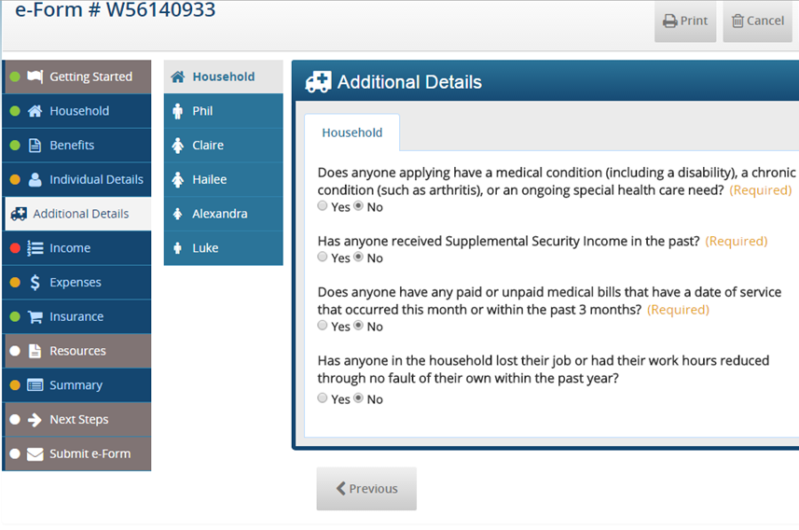
COMPASS Tip
Notes:
*if Kanye marks yes – reviewed in disability categories 1st – will be asked to verify disability & assets
Not required to verify those things, but letter asking won’t say that –
Imagine letter – “we need proof” income, resources, and disability – leads some applicants to drop off

Slide 13
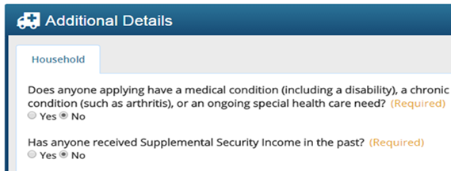
COMPASS Tip
If applicant answers yes, EAF (PA 1663) requested
Note difference between COMPASS and PA 600 HC
Notes:
Common reason for delay / more than denial
EAF requested, but not required (if eligible in adult/expansion category)
Also triggers COMPASS to ask resource Qs

Slide 14
Income
Monthly vs Annual MAGI calculations
Marketplace = projected annual income
Medicaid = actual monthly income
Exception – if monthly income is over 138% and expected to decrease or end, Medicaid uses annual income
Examples
unemployment comp, seasonal labor, school employment
See MAEH 312.53
Notes:
Normally point-in-time

Slide 15
Medicaid Eligibility
For Children
& pregnant women

Slide 16
Category
Definitions:
Child (MAGI)
Age 0-18
until 19th birthday
Children with Disabilities (PH 95)
Age 0-17; until 18th birthday
Former Foster Youth
Up to age 26 (if aged out of foster care)
No income limit, no resource limit

Slide 17
Income Limits
Infants & Pregnant Women (220% FPL)(2016)
*Pregnant Woman is at least a household of two – always count the unborn child(ren)
Household Size | Monthly | Annual
HH of 2* | $2,938 | $35,244
HH of 3 | $3,696 | $44,352
HH of 4 | $4,455 | $53,460
HH of 5 | $5,214 | $62,568

Slide 18
Income Limits
Children age 1 through 5 (162% FPL)(2016)
Household Size | Monthly | Annual
HH of 1 | $1,604 | $19,246
HH of 2 | $2,163 | $25,953
HH of 3 | $2,722 | $32,660
HH of 4 | $3,281 | $39,366
HH of 5 | $3,839 | $46,073

Slide 19
Income Limits
Children age 6 through 18 (138% FPL)(2016)
Household Size | Monthly | Annual
HH of 1 | $1,367 | $16,395
HH of 2 | $1,843 | $22,108
HH of 3 | $2,319 | $27,821
HH of 4 | $2,795 | $33,534
HH of 5 | $3,272 | $39,247

Slide 20
CHIP Income Limits
Children age 0 through 18 (213% + 319% FPL)(2016)
Child need be over income for Medicaid & uninsured
Household Size | Free CHIP Monthly | Low-cost Monthly
HH of 2 | $2,844 | $4,259
HH of 3 | $3,578 | $5,359
HH of 4 | $4,313 | $6,460
HH of 5 | $5,048 | $7,560

Slide 21
Example
Skylar lives with her sons Junior (age 5) and Jessie (age 6). All are uninsured. She works as a pharmacy tech, and earns $2500 per month. Who is eligible for Medicaid or CHIP?
 | Medicaid | Free CHIP | Market- place | Why?
Junior | ✓ |  |  | Age 5; under 162% FPL (HH of 3)
Jessie |  | ✓ |  | Age 6; over 138% FPL, under 213%
Skylar |  |  | ✓ | Parent; over 138% FPL

Slide 22
Modified Adjusted Gross Income
Defining income and household size

Slide 23
What Income Counts
Modified Adjusted Gross Income (MAGI)
Tax-based measure
AGI + tax exempt interest + foreign income
+ Social Security benefits (RSDI)
Rule: income counts unless exempted by tax rules
MAGI counts taxable income
plus 3 specified tax-exempt income types
Notes:
ACA goal - For the MAGI categories, aligns Medicaid rules to the Marketplace rules for premium tax credits
Gross income is taxable income -- adjustments are limited set of deductions
--- modified : 3 add-ons, even though tax exempt

Slide 24
What Income Counts
Types of Income Counted in MAGI
Counted
Wages & tips
UC
Social Security benefits
Pensions
Dividends and interest
Alimony received
Child’s income
(ONLY if required to file tax)
Not Counted
Child support
Workers’ compensation
Veterans’ benefits
Scholarship income
Gifts and inheritances
Notes:
Not exhaustive! General rule – is it taxable?

Slide 25
Example: income types
Skylar lives with her sons Junior (age 5) and Jessie (age 6). Skylar was hurt on the job and receives $1800/month in workers’ compensation. She also receives $600/month in child support.
 | Medicaid | Why?
Junior | ✓ | MAGI = $0. WC and child support do not count. Age 5; under 162% FPL
Jessie | ✓ | Age 6; under 138% FPL
Skylar | ✓ | Adult; under 138% FPL
Notes:
138% for HH 3 = 2311

Slide 26
Example: income types
Skylar lives with her sons Junior (age 5) and Jessie (age 6). Skylar was laid off and receives $1800/month in unemployment compensation. She also receives $600/month in alimony.
 | Medicaid | CHIP | Why?
Junior | ✓ |  | MAGI = $2400/mnth Age 5; under 162% FPL
Jessie |  | ✓ | Age 6; over 138% FPL
Skylar |  |  | Adult; over 138% FPL
Notes:
138% for HH 3 = 2311

Slide 27
Household Size
PA 600 HC, p.3
Notes:
- relevant to income limit – defined in relation to FPL, increase w/ household size
also relevant to whose income counts

Slide 28
Household Size for MAGI
Household size based on “tax unit”
Determines whose income counts
For Medicaid, not required to file taxes
Marketplace vs Medicaid – rules are similar but not the same
Medicaid uses 3 sets of rules: “tax filer” “dependent” & “non-filer”
For atypical households ~ child w/ grandparent, e.g.
Practice tip - apply through COMPASS
Grandparent’s income will not count, e.g.
See MAEH 312, Appendix H desk guide
Notes:
*report to marketplace any household changes – new births, deaths, marriages, divorces
* MAGI income & household rules extend to some Medicaid categories – become general, but then there are exceptions

Slide 29
Immigration Status
In brief

Slide 30
Immigration Status Overview
For Medicaid – two standards:
“Qualified”
Plus five year waiting period for most immigrants
Standard for:
Adults
“Lawfully Present”
Broader than “qualified”
Standard for:
Children
Pregnant women
Adults (state funded GA/MA)
Notes:
Need to know 2 key standards

Slide 31
Lawfully Present
“Lawfully Present”
Legal term of art
Medicaid Standard for:
Pregnant women
Children
Under age 21
GA-related MA
Marketplace standard for all enrollees
Does not include DACA status
https://www.healthcare.gov/immigration-status-and-the-marketplace/
Notes:
When in doubt → look
- changed in 2012 / not with ACA/ with reauthorization of CHIP – PA elected state option
- only insurance option for DACA --

Slide 32
Qualified
“Qualified Alien”
More narrow than “lawfully present”
Standard for most adults
Plus five year waiting period
Depending on the status, may be exempt from “5 year bar”
Have to be in qualified status for 5 years before eligible
No 5 year bar for GA-related MA
Last resort – Emergency Medical Assistance (EMA)
Usually temporary (three months, e.g.)
See MAEH 322.3, Appendix A
Notes:
- age 21+
- legal term of art from 1996 federal legislation / replaced old framework (PRUCOL)
- also added on general rule of 5 year waiting period

Slide 33
Medicaid Eligibility
For Older adults,
adults with disability,
Or Breast/cervical cancer

Slide 34
SSI vs SSDI
Social Security
SSI
Supplemental Security Income
No work history required
$755 /month
Confers Medicaid automatically
SSDI
Social Security Disability Insurance
Requires work history
Benefit typically = $1100-1500/month
Confers Medicare after 2 years!

Slide 35
Healthy Horizons
Healthy Horizons–Two ways to qualify:
Age 65+ <or>
Disability
Social Security Disability Insurance (SSDI), or
Box 1 or 2 on Employability Assessment Form
First option for low-income Medicare beneficiaries
Required to apply for Social Security (if under 65)

Slide 36
Income Limits
Healthy Horizons (100% FPL)(2016)
Plus disregards!
Resource Limit: $2000 (HH of 1)
$3000 (HH of 2+) See MAEH Ch. 319
Household Size | Monthly | Annual
HH of 1 | $990 | $11,880
HH of 2 | $1,335 | $16,020
Notes:
Note lower than 138, expansion category – and harder to get in

Slide 37
Breast & Cervical Cancer Prevention and Treatment
BCCPT
Requires:
Diagnosis of breast or cervical cancer
Or precancerous condition
Uninsured
Under age 65
Separate application (PA 600B) See MAEH Ch. 317
Household Size | Income Limit | Resource Limit
HH of 1 | None! | None!
Notes:
HIPAA’s creditable coverage standard (Medicare Part A sufficient)

Slide 38
Example – take 2
Kanye (age 32) and Kim (age 34) live off Kim’s Social Security Disability of $1700 per month. Kim has Medicare. Does either qualify for Medicaid?
 | Medicaid | Why?
Kanye | ✓ | Under age 65 and & income under 138% FPL (household of 2)
Kim |  | Categorically eligible for Healthy Horizons, but over income
Notes:
Under $1382

Slide 39
Medicaid Eligibility
For workers with disabilities

Slide 40
MAWD
Medical Assistance for Workers with Disabilities
Underused category
High income & resource limits
Minimal work requirement
Many who do not consider themselves “disabled” meet the MAWD disability standard
Age 16-64
Requires 5% premium
Based on recipient’s income only, after disregards

Slide 41
MAWD
“Workers”
work is defined loosely:
no specific hours or wage required
1 hour per week enough
can be informal
requires some amount of paid work monthly
“With Disabilities”
murkier
theory: SSDI or Medical Review Team (MRT) finding: “perm. & totally disabled” w/o regard to actual work
Disability ≠ unable to work
Practice tip: if serious long-term condition, apply!
Notes:
Struggle with depression or anxiety; chronic back-pain → apply!

Slide 42
MAWD–Types of Client
SSDI recipient
Needs to work
Use a simple letter
Include name, work done, amount paid, date, and contact info
see template
Minimal work will not affect SSDI
Worker w/ Ailments
Needs to show ‘disability’
Use either EAF, HSM, or basic doctor’s letter stating:
Diagnosis
Duration
Ask for “presumptive” eligibility
See MAEH 316.2

Slide 43
Income Limits
MAWD (250% FPL)(2016)
Plus income disregards!
Resource Limit: $10,000 (any HH size)
Household Size | Monthly | Annual
HH of 1 | $2,475 | $29,700
HH of 2 | $3,338 | $40,050

Slide 44
MAWD
MAWD vs. Premium Tax Credits
MAWD
5% premium
After disregards
Cost-sharing
No deduct, very small copays ($1/$3 Rx; no PCP copay)
More benefits
Dental, vision, transport.
APTC
Premiums 3% - 9.5%
Sliding scale based on household income
Cost-sharing
Actuarial value: 73%-94%
Compare actual $ amounts
More doctors available?
Notes:
*for some clients, not supposed to have choice, screen as MAWD elig, no PTC

Slide 45
What Income Counts
For Healthy Horizons & MAWD
Key question – is the income earned or unearned?
Follows Social Security rules, not tax rules
Earned Income
Disregard: $65 + half of remaining income
Effectively doubles income limit!
Think of it as counting only $.50 on the dollar
Unearned Income
Disregard: $20
Disregards apply to spousal income, too
Notes:
Earned income – common usage: wages, salaries, profit from self-empl,
nonMAGI categories – work income is special, hugely incentivized

Slide 46
What Resources Count
General rule – all resources count
Including retirement assets and spouse’s resources
Exceptions (plus others, see MAEH 340.8):
House used as residence
Household goods, clothing, et cet.
One motor vehicle
Exception to the resource test altogether:
If child under age 21 in household, no resource test for the parent for Healthy Horizons

Slide 47
Example – take 3
Kanye (age 32) and Kim (age 34) live off Kim’s Social Security Disability of $1720 per month and Kanye’s gross earnings of $2065 per month. Kim has Medicare. Does either qualify for Medicaid?
 | Medicaid | Why?
Kanye |  | Now over income, unless meets MAWD disability standard
Kim | ✓ | With minimal work -> MAWD Countable income: $2,700 (1700+1000)
Notes:
MAWD limit for 2 - $3,338

Slide 48
How to Apply

Slide 49
How to Apply
Online: COMPASS or Healthcare.gov
By phone: 866-550-4355
By mail: paper application (PA 600WD for MAWD)
In person: @ County Assistance Office
*Strongly recommend COMPASS or applying by phone for consumers who appear eligible for Medicaid.
Notes:
Decision w/in 30 days; or 5 days if medical emergency

Slide 50
How to Apply
How quickly will an application be processed?
30 days – normal processing timeframe
5 days – for applicants who have a medical emergency
Does the consumer have recent medical bills?
Medicaid can be retroactive (up to 3 calendar months)

Slide 51
Resources
Medical Assistance Eligibility Handbook
http://services.dpw.state.pa.us/oimpolicymanuals/ma/index.htm
Center on Budget and Policy Priorities – ‘Beyond the Basics’ Series
http://www.healthreformbeyondthebasics.org/
PHLP Medical Assistance Eligibility Manual
http://www.phlp.org/wp-content/uploads/2016/05/Eligibility-Manual-Rev.-2016.pdf
PHLP MAWD Guide
http://www.phlp.org/wp-content/uploads/2016/02/MAWD-Guide-2016.pdf
PHLP Helpline: 1-800-274-3258
Kfisher@phlp.org

